Slide 1


FREELANCING WEBSITE
(Bidding Upwork)

Slide 2





MEET THE TEAM
Rajat Goyal
Rajat Gupta
Mohd. Faizan Khan
20BCS175
20BCS176
20BCS134

Slide 3
PURPOSE AND USABILITY
Hirers can post their work which they want to get done
Users can choose among a category of various niches
HIRERS
MULTIPLE NICHES
FREELANCERS
BIDDING PORTAL
Freelancers will bid on the project of their niche
The elegant bidding portal helps hirers to get the best match for their work

Slide 4




WORKS ON MODERN BROWSERS
CHROME
OPERA
FIREFOX

Slide 5
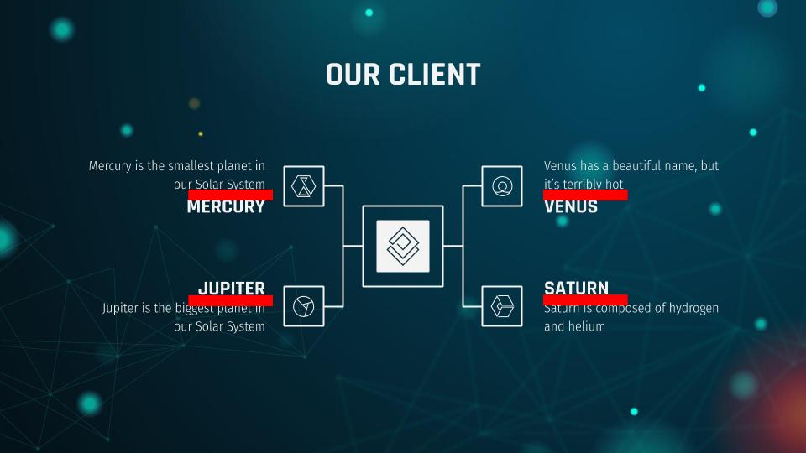

RESPONSIVE WEBSITE
Automatically adjusts itself with different screen sizes

Slide 6
ER DIAGRAM
Project Name
Bidder Id
Project Description
Bidder Name
Bidding Amount
Bid
Project
Bidder
Final Date
Project Id
Hired Bidder
Hired
is
Post
Deal
User
User Id
Hirer
Hirer Name
is
Name
Password (hidden)
Email
Hirer Id

Slide 7






TECHNOLOGIES USED

Slide 8

THANKS!

